Slide 1
NIGERIA COVID-19 ANALYSIS
A brief report on impact of covid-19 in Nigeria.

Slide 2
INTRODUCTION
Coronavirus disease (COVID-19) is an infectious disease caused by a newly discovered coronavirus, and it has affected major parts of the world. Nigeria, a West-African country, has also been affected by the COVID-19 pandemic after recording its first case on 27th February 2020. Nigeria is a country with 37 states - Federal Capital Territory included- and a fast-growing economic environment with about 200 million citizens. COVID-19 has affected several country activities as the country steadily progressed from its first case to shutting down major airports, state-wide lockdown, curfews, and reviving its economy. In this project ,I employ data science & analytics skills to collect data, explore the data, perform analysis, create visualizations, and generate insights.

Slide 3
DATA COLLECTION
I obtained data by performing web scraping on NCDC website. NCDC data contains four columns which include Lab confirmed cases, recovered cases, death cases and discharged cases.
I obtained Nigeria daily data from john Hopkins university center for Systems science and engineering GitHub repository. The repository originally consists of daily covid data across various countries in the world, I extracted from it that of Nigeria only. Three different dataset were obtained from john Hopkins repo.
I also worked with some downloaded dataset which includes GDP and Vulnerability index data, which ranks from low(0) to high(1+).

Slide 4
METHODS
Got my dataset from NCDC website using read html method of Pandas and extracted my data.
I used requests library to obtain my data from JHU CSSE.
Used read csv to obtain the given/downloaded dataset.
Conversion to appropriate data types.

Slide 5
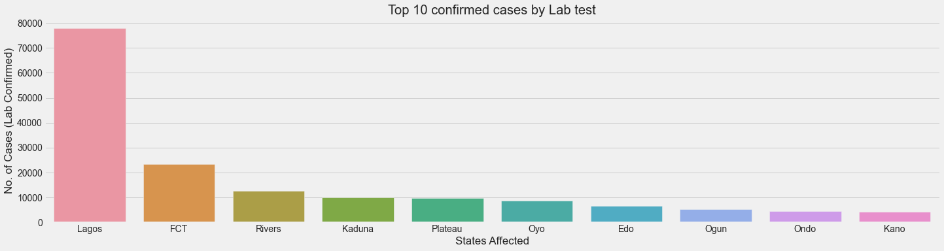
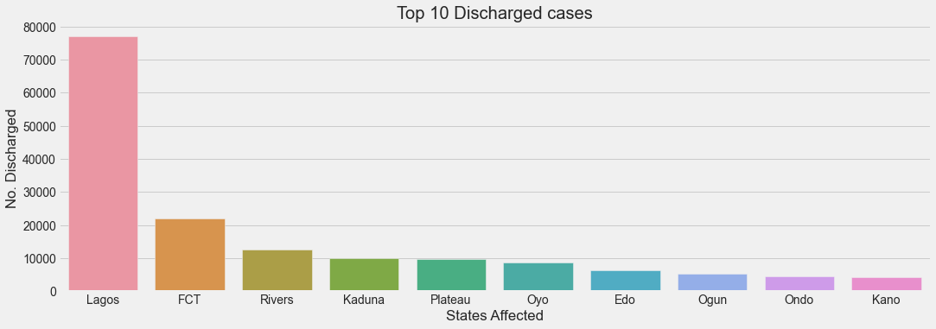
ANALYSIS
From the table, we can see Lagos records the highest number of confirmed cases, followed by FCT, the two economic hub of the Nation.
There’s a linear relationship between confirmed and discharged cases
The two tables follow same pattern in that, cases with highest cases has highest number of discharged patient and vice versa.

Slide 6
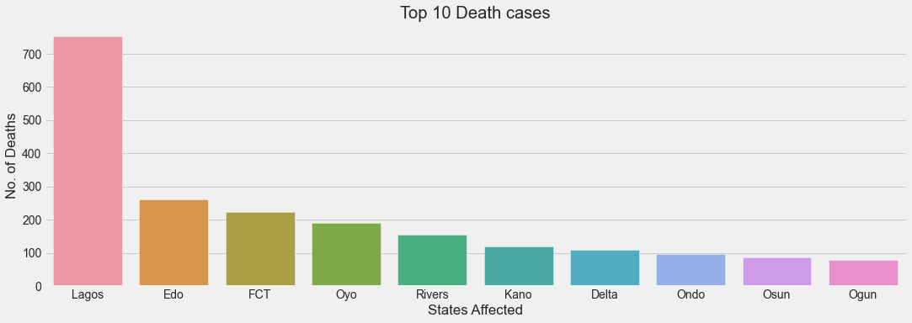
ANALYSIS
This graph is similar to that of confirmed cases and discovered cases, but Edo has the highest death cases as opposed to FCT.
Also, Delta wasn’t part of top 10 confirmed cases, but has the seventh highest death cases. Below Lagos, Edo, FCT, Oyo, Rivers and Kano.
Delta was replaced by Edo here, since Edo has 7th highest confirmed/recovered cases.

Slide 7
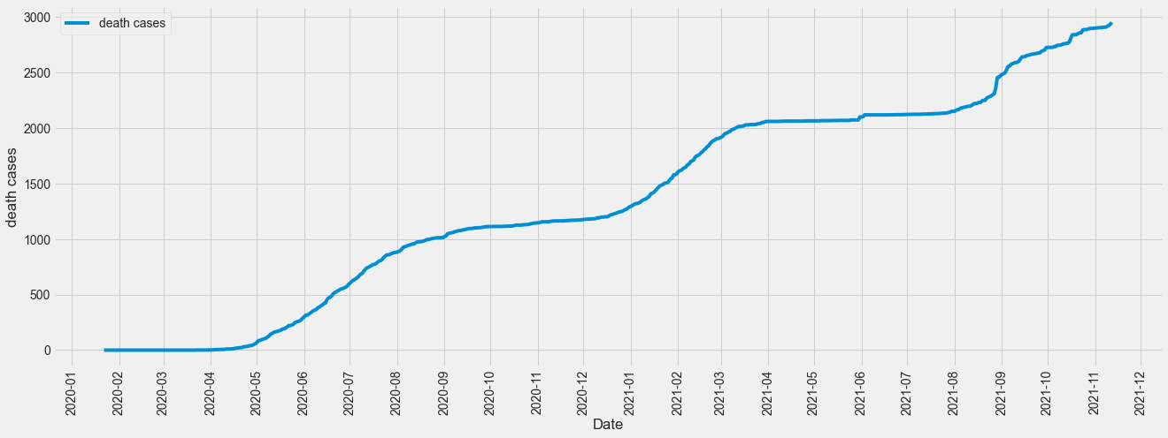
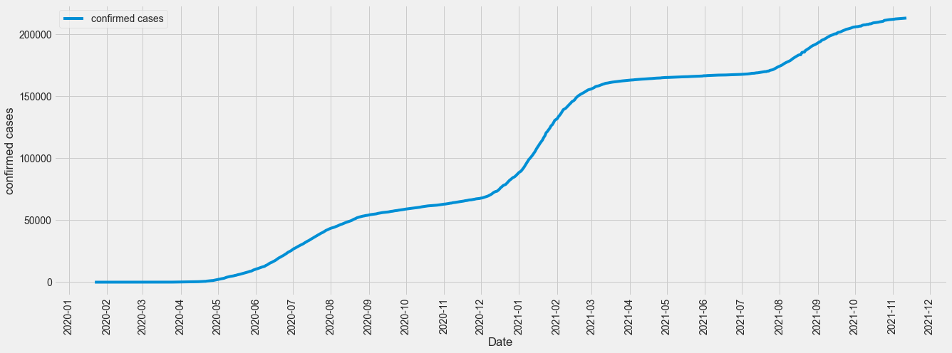
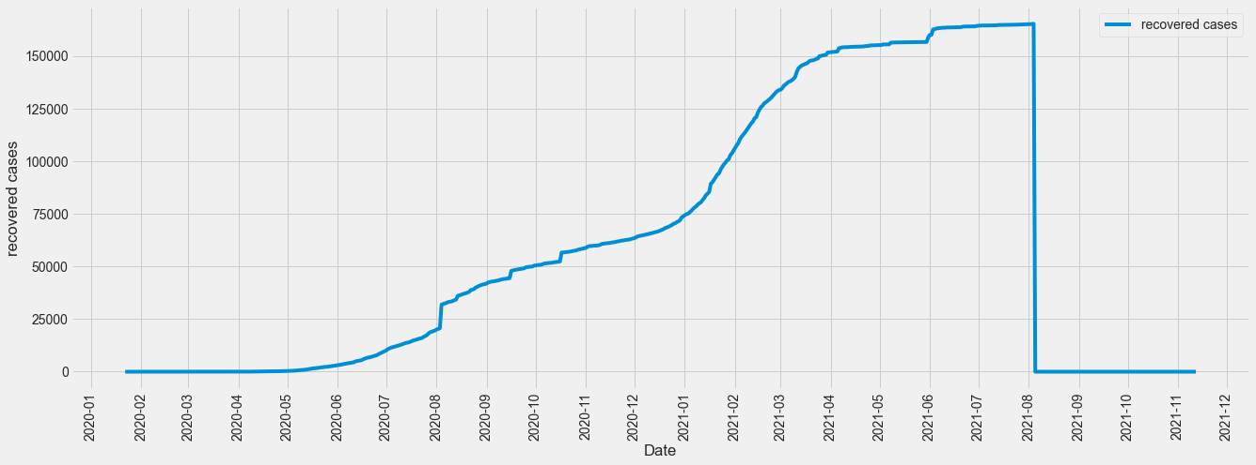
The virus was first discovered in Nigeria late 2019 and it started spreading rapidly, increasingly, till date.
There’s a similar trend for death cases, in increases with increase in number of confirmed cases.
Graph of recovered cases follows same pattern until it reached August 2021, recovered cases dropped drastically.
23rd of January was the day with highest infection rate.

Slide 8
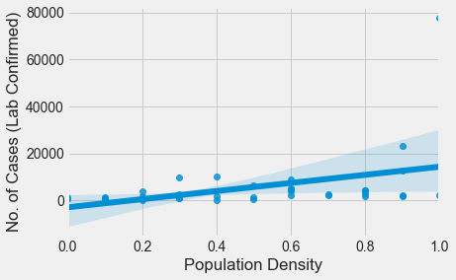
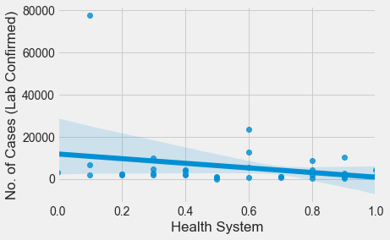
ANALYSIS
There is a positive relationship between Population density and Confirmed cases, i.e the higher the density, the higher the cases confirmed. This clearly explains why Lagos recorded the highest number of cases.
The better the health system, the lower the number of confirmed cases.

Slide 9
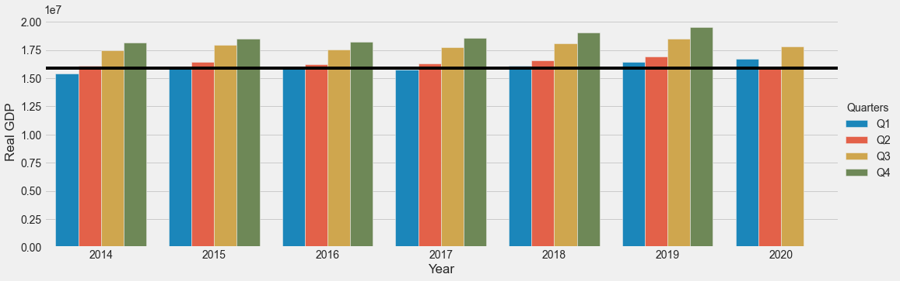
ANALYSIS
Effect of the pandemic was felt in the second quarter of 2020, when a lot of restriction was made. Q2 in 2020 has the lowest GDP since 2014.
According to the Manufacturing Association of Nigeria (MAN), manufacturers’ inventory of unsold goods rose to a record high of N402.4 billion as consumer spending fell.

Slide 10
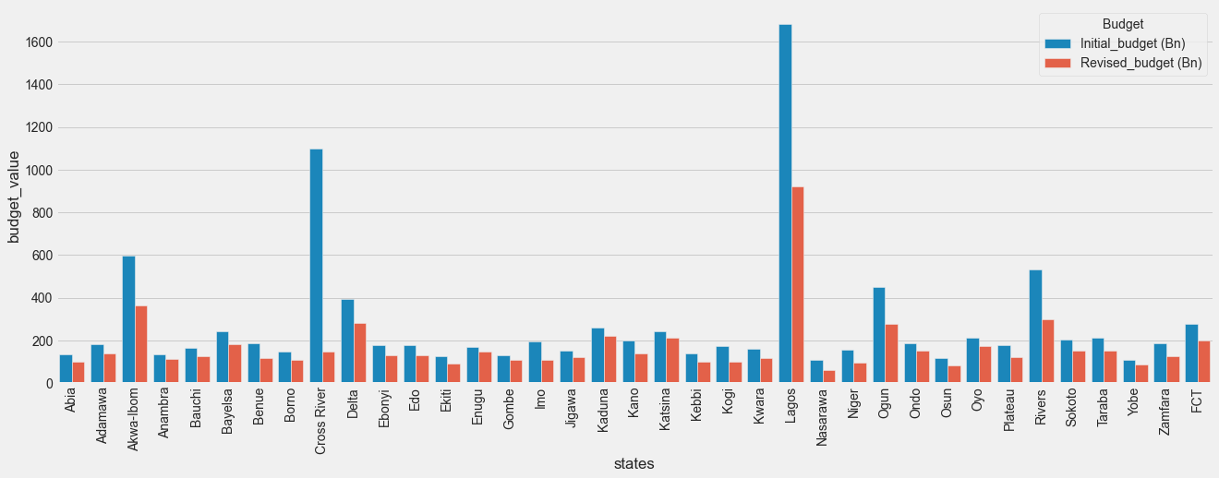
ANALYSIS
Every state has its budget reduced due to the arrival of COVID-19.

Slide 11
CONCLUSION
Covid-19 came as a shock and it’s effect can’t be overemphasized, on economy, manufacturing companies and consumers.
States with high population densities tend to have higher number of confirmed cases. This affirms to the significance of social distancing as a method of keeping safe to avoid contracting the virus.
Despite Borno state having a high fragility value and high Health system due to poor health facilities, the number of cases recorded was still quite low. Reason being that the population density is low.
GDP of Q2 of 2020 was most affected because of the restrictions made by government to reduce the spread of the virus.
There was a reduction in budget for every single state due to covid

Slide 12
REFERENCES
Bloomberg report on economics
Nigeria economic alert (Pwc)

